Slide 1


SLIDE 1
Welcome to our presentation
presentation topics :
Employee Managment Systtem
Our group members are :
Kawser Ahmed ID: 2022-3-60-242
Md. Romjan Ali ID: 2022-3-60-247
Raqibul Hasan ID: 2022-3-60-261
Jobeir Ahmed Dip ID: 2022-3-60-307
Mehedi Hasan Tapu ID: 2021-2-60-154
Arafat Islam ID: 2022-3-60-303
www.reallygreatsite.com

Slide 2


INTRODUCTION:
SLIDE 2
What is Employee Managment System
(EMS)
Why is it important

Slide 3
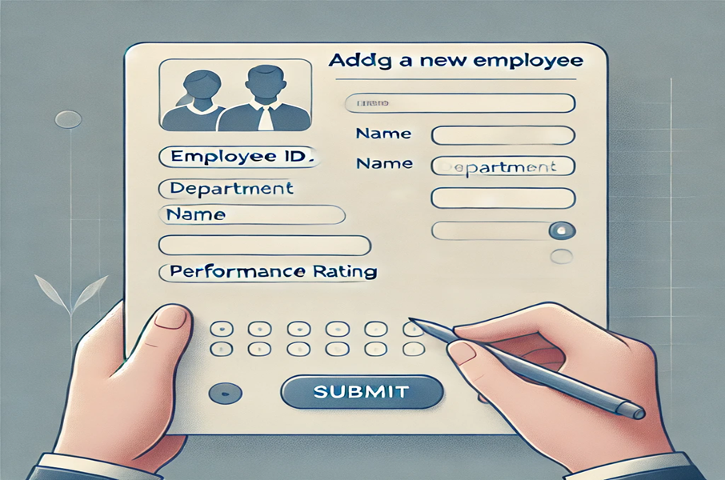

FEATURES:
SLIDE 3
Add a New Employee

Slide 4
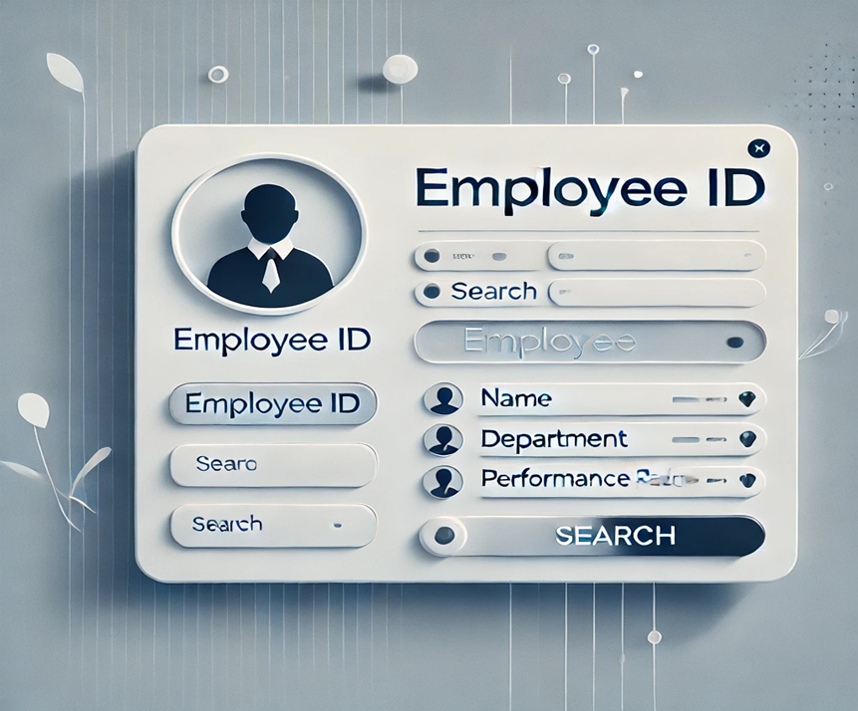

SEARCH BY EMPLOYEE ID:
SLIDE 4

Slide 5

EMPLOYEE LIST DISPLAY OF PARTICULAR DEPARTMENT
SLIDE 5

Slide 6

DIS
DISPLAY ALL EMPLOYEE LIST
display
D
SLIDE 6
display

Slide 7


UPDATING :
SLIDE 7
Adding, Removing or modifiying employee list

Slide 8

DELETING :
SLIDE 8
Permanently remove all
record of a employee
Such as - Name, position,department

Slide 9


FINDING BY
SLIDE 9
RATING

Slide 10

SLIDE 10
ldentified the unique properties among the employees like (GCD)
EXAMPLE:
ID-2022-3-60-247

Slide 11

TIME AND SPACE COMPLEXITY
SLIDE 11
QUICK SORT AND MERGE SORT
O(nlog n)
SELECTION SORT
O(n²)
SPACE COMPLEXITY
O(n)

Slide 12
POINTS FOR THE EXIT KEY
SLIDE 13
Data Saving: Saves all employee records to a file on exit, ensuring no data is lost.
Automatic Reload: Reloads saved data when the system restarts.
Ease of Use: Simplifies data handling with secure and reliable file storage.
Small Business Friendly: Provides essential continuity for managing employee records.

Slide 13
CONCLUSION :
SLIDE 14
The Employee Management System
is an effective tool for managing employee data,
offering features like sorting, searching, and data persistence.
While simple, it ensures reliability and lays
the groundwork for future improvements, making it ideal for small businesses.

Slide 14

SLIDE 15
THANK
YOU!
Thank you for exploring the essential steps and considerations in our project. Feel free to ask questions!

